Slide 1

Programming for Engineers
BEP2073
>> Slide 8.2
>> Data Science (Part 2)
Machine Learning and Artificial Intelligence

Slide 2
Course Learning Outcome
CLO1 | Outline the operational procedure of programming language.
CLO2 | Outline the object-oriented attribute in the programming flow.
CLO3 | Evaluate the program structure on function, branching and condition.
CLO4 | Develop a programming/syntax solution for chemical engineering case study.
CLO5 | Differentiate between solution error and syntax error for complex engineering case study

Slide 3







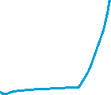






Slide 4






Important Python Libraries for AI & ML
• Numpy Tutorial
• Pandas Tutorial
• Matplotlib Tutorial
• Tensor Flow Tutorial
• Keras Tutorial
https://colab.research.google.com/drive/1V-1Q5Yvt-bQtLfQTKUb9ylQFkiSakTN0?usp=sharing

Slide 5











Library: Tensor Flow
An end-to-end open-source machine learning platform
TensorFlow is an end-to-end open-source platform for machine learning.
It has a comprehensive, flexible ecosystem of tools, libraries and community resources.
To build and deploy ML powered applications.
import tensorflow as tf
from tensorflow import keras
from tensorflow.keras import layers

Slide 6
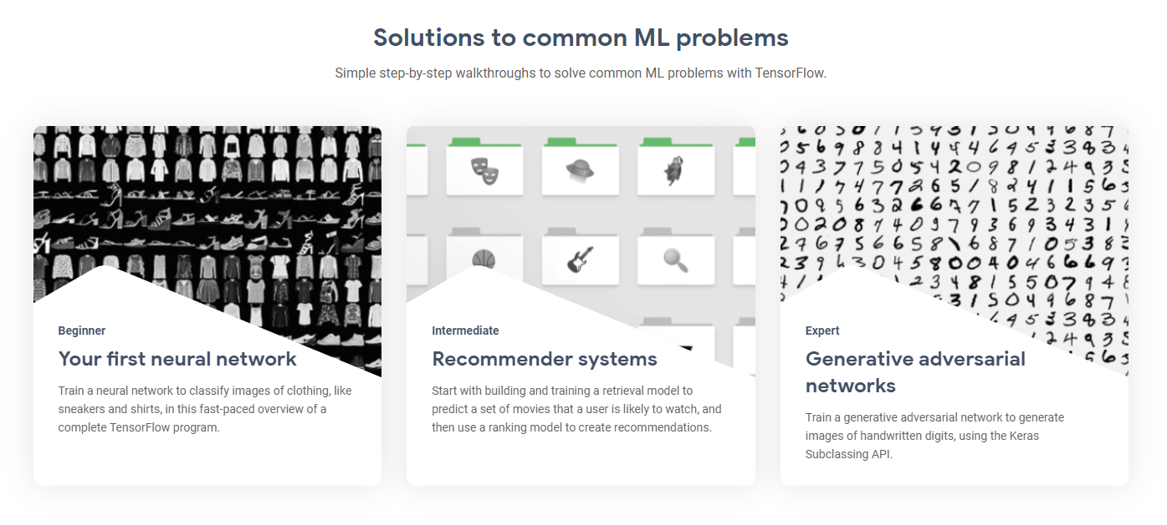





https://www.tensorflow.org/

Slide 7












Keras
Simple. Flexible. Powerful.
Deep learning for humans.
Keras is an API designed for human beings, not machines.
Keras offers consistent & simple APIs.
It also has extensive documentation and developer guides. https://keras.io/guides/
import tensorflow as tf
from tensorflow import keras
from tensorflow.keras import layers

Slide 8

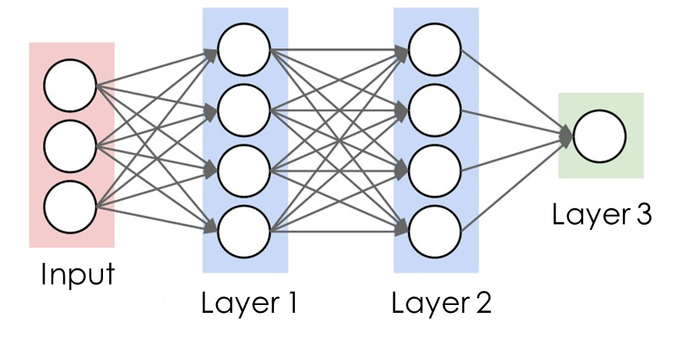

Call model on a test input
X1 = 1
y = ?
X2 = 1
X3 = 1
# Call model on a test input
x = tf.ones([1,3])
y = layer3(layer2(layer1(x)))

Slide 9

AI & ML in Python
!pip install -U tensorflow-addons
import numpy as np
import pandas as pd
import matplotlib.pyplot as plt
import tensorflow as tf
from tensorflow import keras
from tensorflow.keras import layers

Slide 10



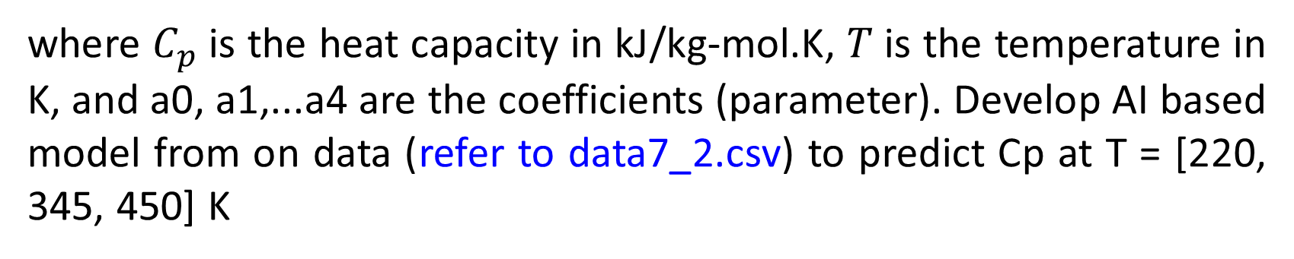
Exercise 1: Regression
The following data were gathered to determine the relationship between heat capacity and temperature of a Carbon disulfate, CS2. The temperature dependency of the heat capacities of gases is commonly represented by simple polynomials of the form:
$$C_{p}\left(T\right)=a_{0}+a_{1}T+a_{2}T^{2}+a_{3}T^{3}+a_{4}T^{4}$$
where $C_{p}$is the heat capacity in kJ/kg-mol.K, 𝑇 is the temperature in K, and a0, a1,...a4 are the coefficients (parameter). Develop AI based model from on data (refer to data7_2.csv) to predict Cp at T = [220, 345, 450] K

Slide 11






















Slide 12








Slide 13

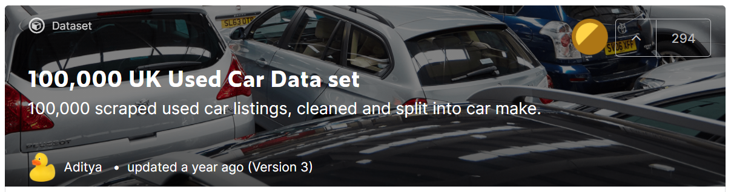
Case Study: Apply Lifecycle of Data science
Find Useful Insight based on the Used Car Data set as below
Link: https://www.kaggle.com/adityadesai13/used-car-dataset-ford-and-mercedes/tasks?taskId=1258

Slide 14


Slide 15
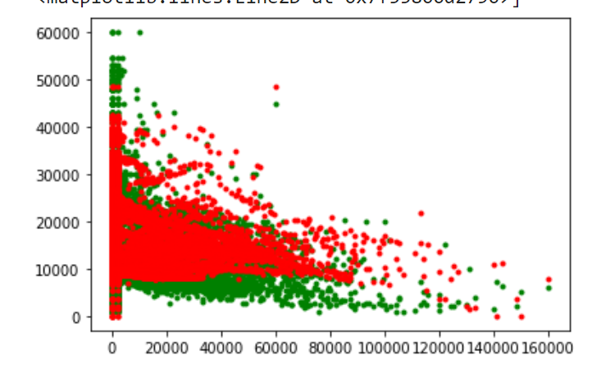

Slide 16
End

